Slide 1
SQL (IV) Functions, Stored Procedures, Triggers
IST 659

Slide 2
Important announcement
We will have an open-book quiz next Monday!
It will focus on JOIN queries and today’s lecture.

Slide 3
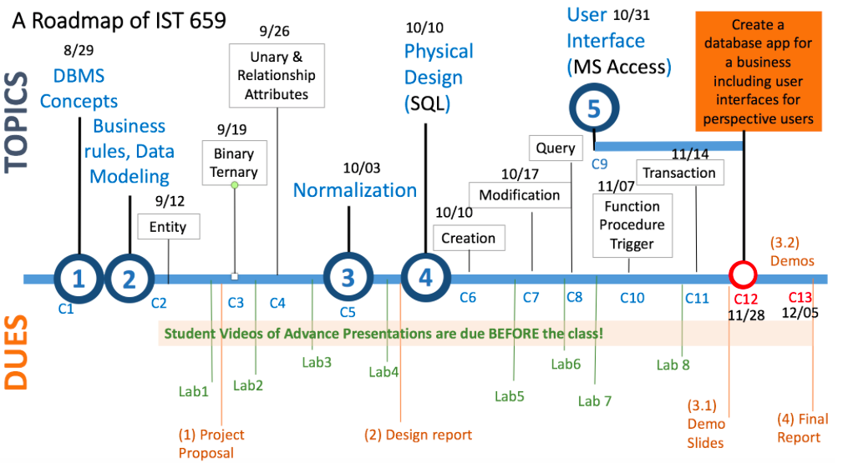
We are here today.

Slide 4
Today’s Goals
Concepts
Functions:
Scalar function: think about count(), sum()
Table-valued function: with input v.s. without input
Stored Procedures:
think about a set of commands you can explicitly execute to update your tables, to insert new records or delete some records
Triggers
think about some secret functions behind the scenes that can be automatically executed when some events happen, e.g. after your birthday, the age column is incremented by 1
Skills
Able to CREATE your functions, stored procedures and triggers
Able to appropriately call them either with or without providing any parameters
Able to understand what happens after a trigger is executed

Slide 5
Functions

Slide 6
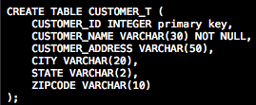
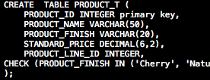

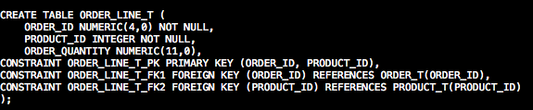
Explore Today’s Tables
Open the creation script

Slide 7
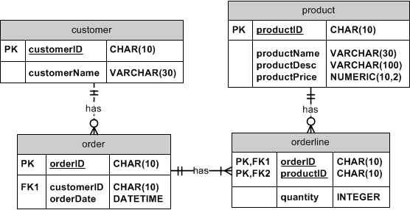

Example I
The customer service needs to know how much balance a particular order, e.g. orderID=1001, has?
Notes:
We can’t expect everybody to know SQL and to be able to write it within 10 seconds, so we write a function that you can call the function directly.

Slide 8
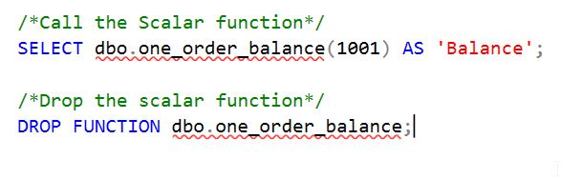
Scalar function
Given an orderID, the function returns the total balance of the order.
Scalar function: returns a single data value.

Slide 9
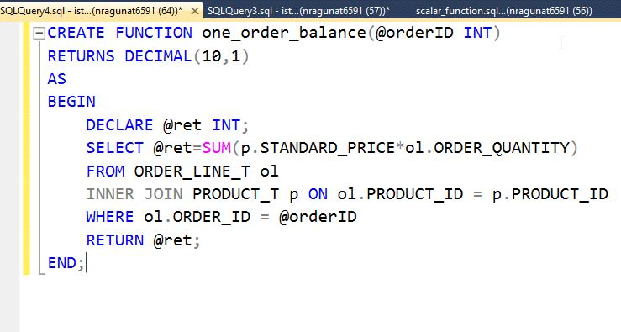
An Overview of the Scalar function
It takes one input value, and returns a single data value.

Slide 10
Scalar function – Step by Step Illustration
The parameter is defined in the CREATE clause, then is used in the script
The variable is used in the script, then receives value by assigning the values in the SELECT clause, and finally returns the value in the RETURN clause at the end.

Slide 11
Call and Drop a Function
Scalar function is called by the SELECT clause

Slide 12

Example II
The sales manager wants to know total balances of all orders.
Notes:
We can’t expect everybody to know SQL and to be able to write it within 10 seconds, so we write a function that you can call the function directly.

Slide 13
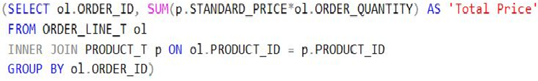
Table – Valued Functions (No Input)
It takes no input, and returns a table

Slide 14

Call a table-valued function
Table-valued function is called by the FROM clause

Slide 15

Example III
The sales manager wants to know which orders brought in revenue over $1000.
Notes:
We can’t expect everybody to know SQL and to be able to write it within 10 seconds, so we write a function that you can call the function directly.

Slide 16

Table – Valued Functions (With Input)
It takes one input, and returns a table
The parameter is defined in the CREATE clause, then is used in the script

Slide 17

Call a table-valued function with an input
Table-valued function with an input parameter is called by the FROM clause

Slide 18
Summary - Functions
A Function can be used inline in SQL Statements
if it returns a scalar value (in the SELECT clause)
or can be joined upon if it returns a result set (used in the FROM clause).
Functions compute values and cannot perform permanent environmental changes to SQL Server
no INSERT or UPDATE statements allowed.

Slide 19
Stored procedures

Slide 20
Stored Procedure
Anything that manipulates data must be a procedure.
Think about INSERT, UPDATE or DELETE

Slide 21
Example IV
Each customer wants to know his/her own balance.
this field needs to be updated each time a new order is made or canceled for the customer
Notes:
We can’t expect everybody to know SQL and to be able to write it within 10 seconds, so we write a function that you can call the function directly.

Slide 22
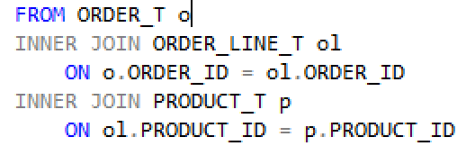

A procedure with Parameter
It takes one input, and updates that customer’s balance.
The parameter is defined in the CREATE clause, then is used in the script to update the CUSTOMER_T table only for the given customer ID
Parameter value of the stored procedure, i.e. the customerID.

Slide 23
Example V
Update all customers’ balance for annual reports.
Do not take any parameter
Notes:
We can’t expect everybody to know SQL and to be able to write it within 10 seconds, so we write a function that you can call the function directly.

Slide 24

A procedure Without a parameter
Updates all customers’ balance without taking any input parameter.
??
Notes:
The procedure calculates total price of customer’s each order

Slide 25
Summary
Stored procedures are called explicitly by using EXEC storedprocedure name

Slide 26
Triggers

Slide 27
Trigger
Unlike stored procedures, triggers automatically execute when an event occurs in the database server.
Data Manipulation Language events include: INSERT, UPDATE, or DELETE statements on a table or view
Data Definition Language events include: CREATE, ALTER, and DROP
Logon events

Slide 28
Example VI
Automatically update customer balance if any changes are made to the orderline table
It can be one orderline record or multiple records affected
Notes:
We can’t expect everybody to know SQL and to be able to write it within 10 seconds, so we write a function that you can call the function directly.

Slide 29

Trigger – updating multiple rows
Automatically update customers’ balance after order information is modified.
the local variable @@RowCount holds the number of records changed by the last SQL statement executed

Slide 30
Improving performance of Trigger by using Inserted
Automatically update customers’ balance after order information is modified.
Think inserted as a temporary table, where the affected rows by insert or update operations are kept.

Slide 31

Test the Trigger
What’s the balance of customerId=1?
The balance of customerId=1 should be updated

Slide 32
Additional Readings
Text book
Chapter 7
Best Practices
http://www.c-sharpcorner.com/UploadFile/skumaar_mca/good-practices-to-write-the-stored-procedures-in-sql-server/
Error handling
https://msdn.microsoft.com/en-us/library/ms175976.aspx
Security context
https://msdn.microsoft.com/en-us/library/bb669087(v=vs.110).aspx
Notes:
All the additional readings are listed on the syllabus. I will be very proud of myself if you can understand the concepts and build up the skills by only relying on my slides, because I designed them to help you learn effectively. But if you want more details, the syllabus has provided the text book and corresponding chapters.

Slide 33
Review Today’s Lecture
Questions you need to answer before writing your own functions, procedures or triggers:
What data question or operations do you need to make?
What type of data will the function return?
What input parameters do you need to define for the function or stored procedure?
Functions
Scalar Functions
Table Valued Functions (No Input)
Table Values Functions (With Input)
Stored Procedures
With Parameters
Without parameters
Triggers
Multiple row update trigger
You can also learn how to use INSERTED or DELETED to modify only one row after a triggering event e.g. https://www.mssqltips.com/sqlservertip/2342/understanding-sql-server-inserted-and-deleted-tables-for-dml-triggers/

